Slide 1
MCA Final Year Project (Review 3) “Drowsy Driver Detection System Using Deep Learning”
Submitted to the Presidency University, Bengaluru in partial fulfillment for the award of the degree of Master of Computer Applications(MCA)
Project Number : 221
Under the supervision of
Mr. Sakthi S Asst. Prof, Department of SCSE School of Computer Science and Engineering
Name | Roll Number
Ankitha G | 20232MCA0012

Slide 2
Content
Problem Statement
Literature Survey
Tools and Technologies to be used
Timeline of the Project
GitHub Link
References

Slide 3
Problem Statement
Design a real-time drowsy driver detection system that monitors signs of fatigue, such as slow blinking, mouth closure, and head movement.
The system should distinguish between normal and drowsy driving behavior, providing immediate auditory alerts to encourage breaks.
It must work in various lighting conditions, adapt to different driver behaviors,
It should be easy to install, reliable, cost-effective, and scalable for diverse vehicles and driving scenarios.

Slide 4
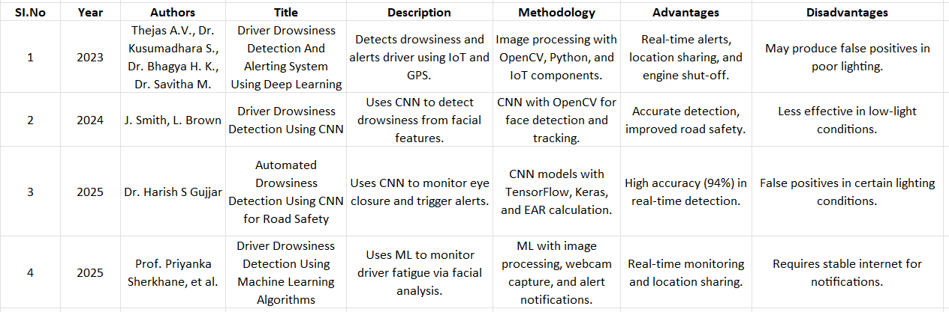
Literature Review

Slide 5
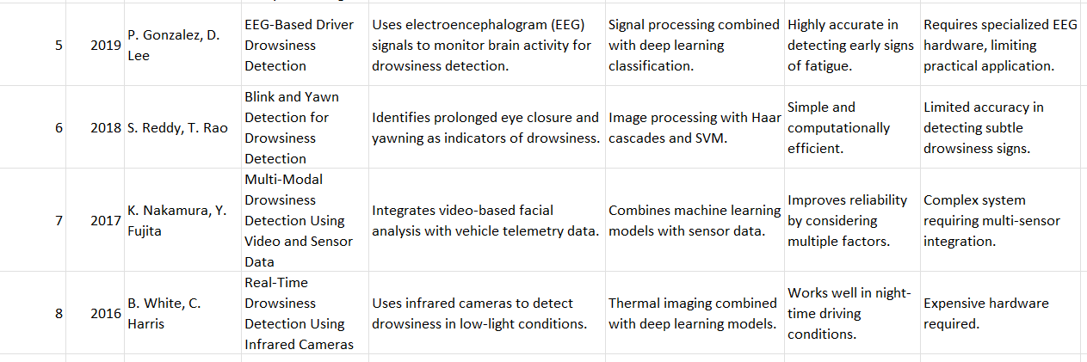

Slide 6
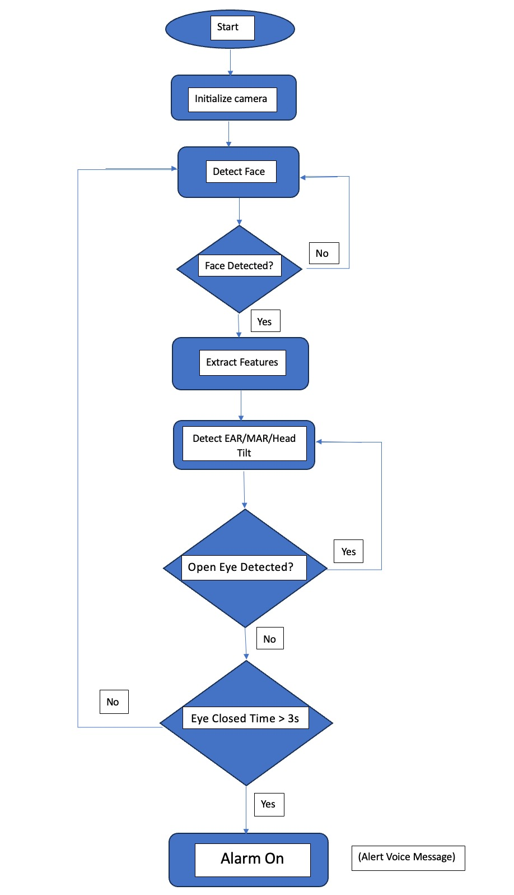
Module Design

Slide 7
Start & Initialize Camera: The system begins by activating the camera to monitor the driver.
Detect Face: It checks for the presence of a face. If no face is detected, it loops back to keep searching.
Extract Features: Once a face is detected, the system extracts facial features.
Detect EAR/MAR/Head Tilt: It analyzes the facial landmarks to calculate parameters like Eye Aspect Ratio (EAR), Mouth Aspect Ratio (MAR), and head tilt.
Open Eye Check: The system checks whether the driver’s eyes are open.
If yes, it continues monitoring.
If no, it checks how long the eyes remain closed.
Eye Closed Time > 3s: If the eyes are closed for more than 3 seconds, the system triggers an alarm.
Alarm Activation: The alarm turns on with a voice message to alert the driver.

Slide 8
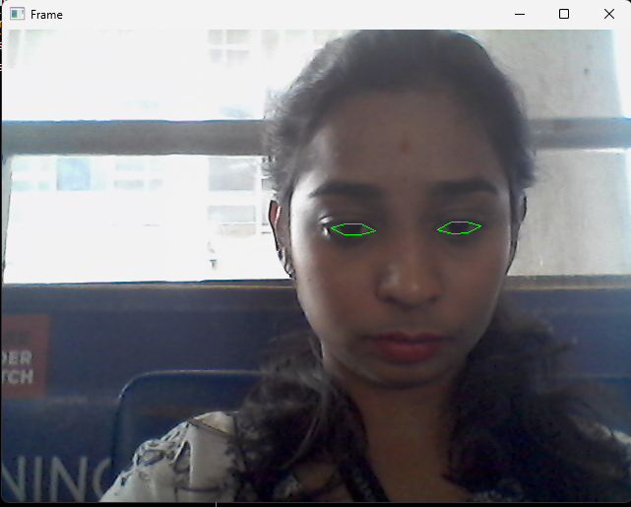
Module 1: Camera Initialization & Video Capture
Purpose: Activates the webcam and captures real-time video feed.
Key Code Elements:
python
cap = cv2.VideoCapture(0)
Tasks:
Initialize webcam.
Continuously read frames.
Convert each frame to grayscale for processing.

Slide 9
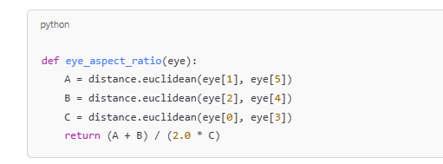
Module 2: Face & Landmark Detection
Purpose: Detects the face and extracts facial landmarks using dlib.
Key Code Elements:
python
detect = dlib.get_frontal_face_detector() predict = dlib.shape_predictor("shape_predictor_68_face_landmarks.dat")
Tasks:
Face detection.
Landmark extraction (eyes and mouth).
Convert landmarks to NumPy arrays for analysis.
Input | Output
Face image | EAR value, drowsiness status

Slide 10
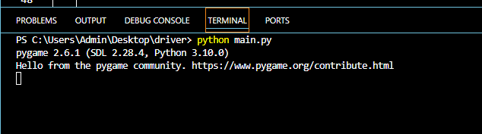
Module 3: Feature Extraction (EAR & MAR Calculation)
Purpose: Calculates Eye Aspect Ratio (EAR) and Mouth Aspect Ratio (MAR) to determine drowsiness indicators.
Key Code Functions:
python
def eye_aspect_ratio(eye): ... def mouth_aspect_ratio(mouth): ...
Tasks:
Compute EAR for both eyes and take average.
Compute MAR for mouth.
Prepare for threshold-based decisions.

Slide 11
Module 4: Drowsiness Detection Logic
Purpose: Applies thresholds to EAR and MAR values to detect drowsiness and trigger alerts.
Logic Summary:
If EAR < 0.22 for more than 3 frames or MAR > 0.7, trigger alarm.
Stop alarm when conditions are no longer met.

Slide 12
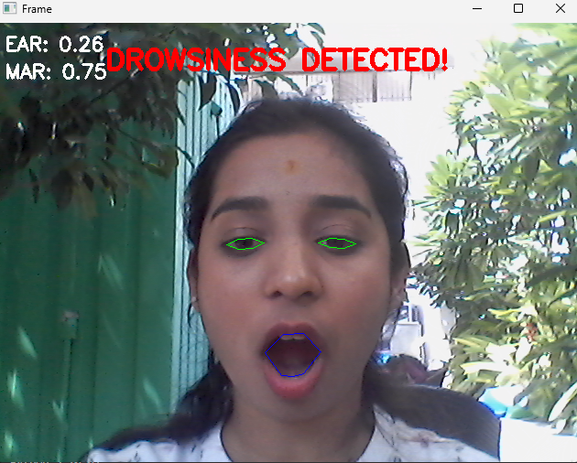
Module 5: Alert System & Visualization
Purpose: Provides auditory alerts and visual feedback on screen.
Key Features:
Audio alert using pygame.mixer.
Real-time EAR and MAR display.
Draws contours around eyes and mouth.
Shows warning text if drowsy.

Slide 13
Tools And Technologies To Be Used
Software Technologies
Programming Language: Python 3.7+
Libraries and Frameworks:
OpenCV: Image processing and video analysis.
Dlib: Facial landmark detection.
Mediapipe: Face mesh detection.
NumPy & SciPy: Numerical computations.
Imutils: Image processing utilities.

Slide 14
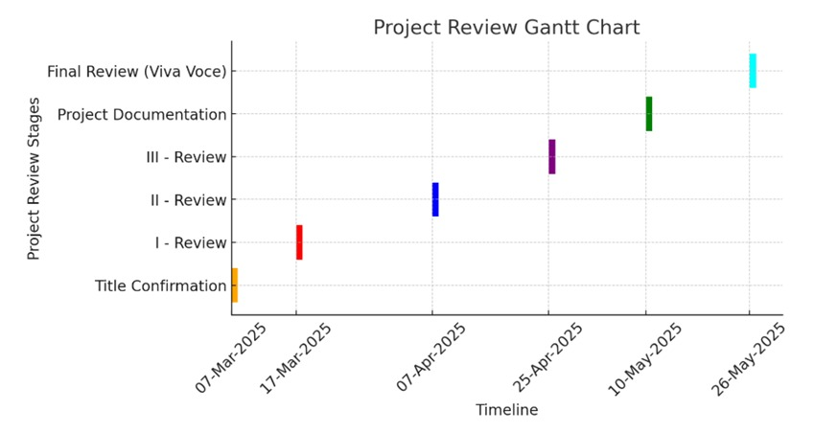
Project Timeline

Slide 15
GitHub Link
https://github.com/Rajankitha/Drowsy-Driver-Detection-Using-Deep-Learning-

Slide 16
References
Thejas A.V., Dr. Kusumadhara S., Dr. Bhagya H. K., and Dr. Savitha M., "Driver Drowsiness Detection And Alerting System Using Deep Learning," International Journal of Creative Research Thoughts (IJCRT), vol. 11, no. 7, pp. 777–784, July 2023. [Online]. Available: IJCRT2307777
J. Smith, L. Brown , "Driver Drowsiness Detection Using CNN," Journal of Emerging Technologies and Innovative Research (JETIR), vol. 11, no. 6, pp. 93–101, June 2024. [Online]. Available: JETIRGG06093
Dr. Harish S. Gujjar, "A Deep Learning Approach to Automated Drowsiness Detection in Drivers Using CNN Models for Enhanced Road Safety," Proceedings of the International Conference on Emerging Trends in Technology and Science, 2025, pp. 1–8.
Prof. Priyanka Sherkhane, Sahane Purvesh Vaibhav, Bibin Yohannan, Shaikh Mohammed Saqib Abdul Shakoor, and Gade Rohan Kailas, "Driver Drowsiness Detection Using Machine Learning Algorithms," The International Journal of Engineering Research (TIJER), vol. 25, no. 1, pp. 13–21, 2025. [Online]. Available: TIJER2501013

Slide 17
H. Garg, "Drowsiness Detection of a Driver using Conventional Computer Vision Application," 2020 International Conference on Power Electronics & IoT Applications in Renewable Energy and Its Control (PARC), Mathura, India, 2020, pp. 236-556, doi: 10.1109/parc49193.2020.236556.
K. H. Lee, W. Kim, H. K. Choi, and B. Tae Jang, "A Study on Feature Extraction Methods Used to Estimate a Driver’s Level of Drowsiness," 2019 21st International Conference on Advanced Communication Technology (ICACT), PyeongChang, South Korea, 2019, pp. 1-5, doi: 10.23919/icact.2019.870192.
B. G. Pratama, I. Ardiyanto, and T. B. Adji, "A review on driver drowsiness based on image, bio-signal, and driver behavior," 2017 3rd International Conference on Science and Technology - Computer (ICST), Yogyakarta, Indonesia, 2017, pp. 1-6, doi: 10.1109/icstc.2017.8011855.

Slide 18


